Slide 1
Social Testing: A Framework to support adoption of continuous delivery by SME’s
Jonathan Dunne, David Malone, Jason Flood.
NetLab - August 2015

Slide 2
Agenda:
1. Introduction
2. Background Research
3. Analysis
4. Results
5. Conclusion

Slide 3
Introduction

Slide 4
Background Research

Slide 5
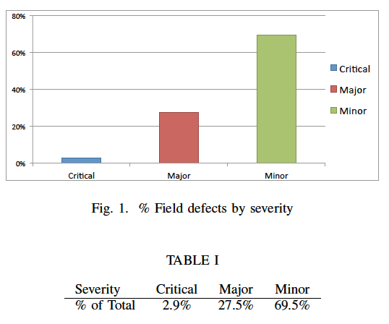
Analysis – Defect Impact

Slide 6
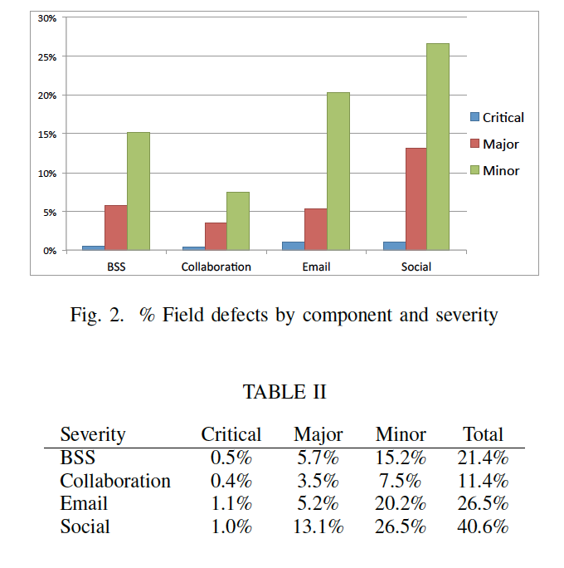
Analysis – Defect Component

Slide 7
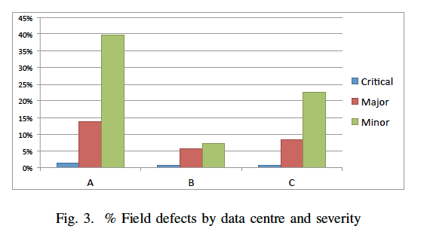
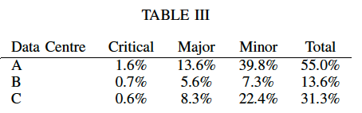
Analysis – Data Centre

Slide 8
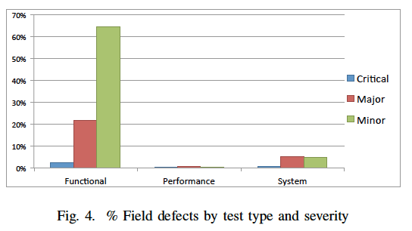
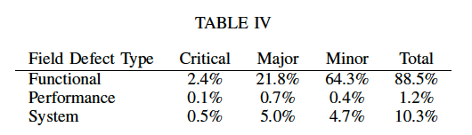
Analysis – Defect Type

Slide 9
Results

Slide 10
Conclusion
Previous studies have shown that:
Field defect analysis is a worthwhile exercise.
Bug bounty programs provide an incentive for users to improve software quality.
Our study has shown that:
Customers are useful at finding certain types of defects: Functional low impact.
Field defect data can be used to create a test in-house frameworks.
These frames allow test team to focus on high value test areas.
Future work:
Study of in-house defect deferrals vs field defects found.

